Slide 1
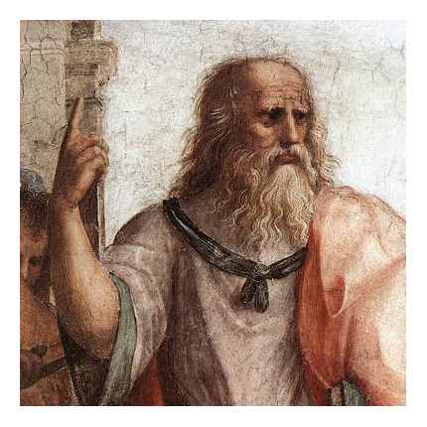
HUMA2921 Ethical Theories and Contemporary Issues
Prof. Plato Tse
NCCU & HKUST

Slide 2
Kant on the Idea of Duty
“Everyone must grant that a law, if it is to hold morally, i.e. as a ground of an obligation, must carry with it absolute necessity; that the command: thou shalt not lie, does not just hold for human beings only, as if other rational beings did not have to heed it; and so with all remaining actual moral laws; hence that the ground of obligation here must not be sought in the nature of the human being . . . [but] solely in concepts of pure reason” (G, 4:389/44–45).

Slide 3
Kant on the Idea of Duty
Holds for all rational agents
Non-human rational agents, if they exist, are also bound by the moral law.
Grounded in practical reason, not in specific facts about human beings
Practical reason concerns one’s capacity to deliberate and make free choices.

Slide 4
Demands of Practical Reason
Categorical Imperative (CI)
Categorical: unconditional
Imperative: command
Hypothetical Imperative (HI)
If one intends E and recognizes that doing A is necessary for bringing about E, then do A (or give up E).
Only conditionally valid

Slide 5
Morality
What morality does and does not involve:
Duty involves there being some action (or omission) that one must do (or omit) regardless of what ends one might happen to adopt.
Hence, morality cannot be a system of HI.
Hence, morality is not a doctrine of personal happiness.
Why?

Slide 6
Supreme Principle of Morality
Kant distinguishes two sorts of ends:
Ends that we adopt based on our desires
They acquire worth or value for us by being objects of our choice.
Ends in themselves
According to Kant, there is such an end: “Rational nature exists as an end in itself” (G, 4:428–29/79).

Slide 7
Supreme Principle of Morality
What is so special about the rational nature?
“Autonomy is . . . the ground of the dignity of human nature and of every rational nature” (G, 4:436/85).
“The ground of the possibility of categorical imperatives is this: that they refer to no other property of choice (by which some purpose can be ascribed to it) than simply to its freedom” (MM, 6:222/377).

Slide 8
Formula of Humanity
If something has unconditional value, then there is an unconditional requirement to respect it—the kind of response that something with such worth calls for.
Anything with the status of an end in itself has unconditional value.
Our nature as autonomous agents makes us ends in ourselves.
Thus, there is a basic unconditional requirement to respect the autonomy of agents.

Slide 9
Formula of Humanity
Formula of Humanity (FH):
“So act that you use humanity, in your own person as well as in the person of any other, always at the same time as an end, never merely as a means.” (G, 4:429/80)
Negative part: Prohibits treating persons merely as a means to one’s ends
Positive part: Requires the promotion of certain ends

Slide 10
Formula of Humanity
Compare:
You ask your friend to drop you off at the airport and your friend willingly agrees.
A mugger demands his victim to hand over his wallet or else be shot to death.
Nothing morally wrong in the former case: your friend is a means but not merely a means
In the latter case: the victim is a mere means and nothing more

Slide 11
Formula of Humanity
Regarding = Treating?
A gangster “who regards most other people as mere means, and who would injure them whenever that would benefit him. When this man buys a cup of coffee, he treats the coffee seller just as he would treat a vending machine. he would steal from the coffee seller if that was worth the trouble, just as he would smash the machine. But though this gangster treats the coffee seller as a means, what is wrong is only his attitude toward this person. in buying his cup of coffee, he does not act wrongly” (2011, 216).

Slide 12
Formula of Humanity
“It is not enough that the action not conflict with humanity in our person, as an end in itself, it must also harmonize with it” (G, 4:430/80–81).
Positive requirement of FH:
Self-perfection
The happiness of others

Slide 13
Kant’s System of Duties
Categorical imperative → two very general duties → more specific duties
CI requires us to protect and promote the humanity in oneself and others.
“The capacity to set oneself an end—any end whatsoever—is what characterizes humanity.” (MM, 6:392/522)
This capacity requires developing certain powers, thereby perfecting oneself.

Slide 14
Kant’s System of Duties
All human beings naturally wish to be happy.
I recognize my own happiness (in general, not in every particular case) as a legitimate end.
If I take others seriously (as ends in themselves), then I ought to take their ends as my own – I ought to help them.
Hence, the promotion of humanity in others requires me to pursue others’ happiness.

Slide 15
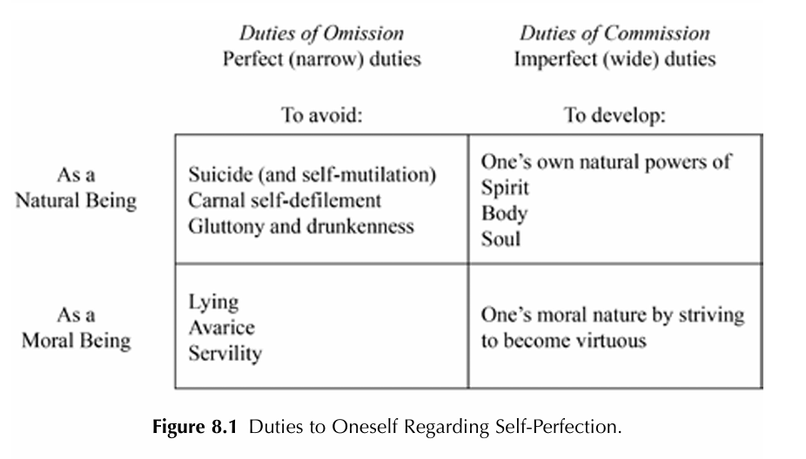
Duties to Oneself Regarding Self-Perfection
Perfect: One must never (or always) φ to the fullest extent possible
Imperfect: One must sometimes and to some extent φ

Slide 16
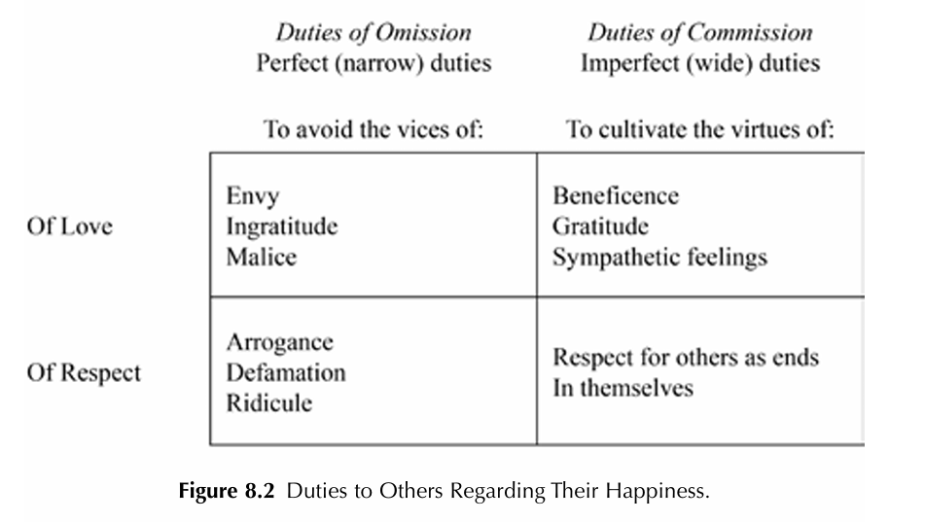
Duties to Others Regarding Their Happiness
The vices are attitudes that hinder us from our duties.
The virtues are attitudes that facilitate our duties.

Slide 17
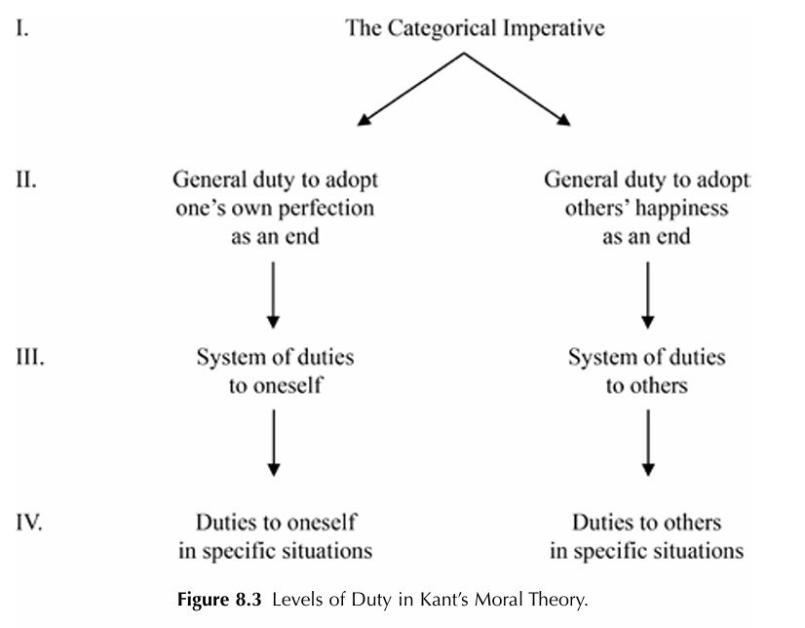
Levels of Duty

Slide 18
Kant emphasizes on the importance of application:
“A metaphysics of morals cannot dispense with principles of application, and we shall often have to take as our object the particular nature of human beings, which is cognized only by experience, in order to show in it what can be inferred from universal moral principles” (MM, 4:217/372).
Going from level 3 to level 4 requires casuistry – a procedure of applying principles to specific cases
Levels of Duty

Slide 19
Levels of Duty
Lizbeth’s lie. Lizbeth is hiding an acquaintance, Tom, who is wrongly believed by some murderous gang members to have ratted out one of their gang to the police. A gang member shows up at Lizbeth’s front door, asking her for the whereabouts of Tom. Telling the truth would surely lead to the murder of Tom, and so would (let us suppose) just refusing to answer. So, Lizbeth lies, saying that she doesn’t know where Tom is.
“The stronger ground of obligation prevails.” (MM 6:224/379).

Slide 20
An action A in C is obligatory iff failing to perform A in C would fail to respect humanity by treating oneself or others merely as means to some non-moral end.
An action A in C is wrong iff performing A in C would fail to respect humanity by treating oneself or others merely as means to some non-moral end.
An action A in C is optional iff neither performing A in C nor omitting A in C fails to respect humanity.
Theory of Right Conduct: Humanity Formulation

Slide 21
Formula of Universal Law
“Act only according to that maxim through which you can at the same time will that it become a universal law” (G, 4:421/73).
FH: a fundamental criterion of right action
FUL: a decision procedure to guide moral deliberation
Maxim: “a subjective principle of volition” (G, 4:402n/56) on which an agent acts whenever she acts intentionally.

Slide 22
General semantic form of maxim:
I will ________, if/when ________ in order to ________.
Maxim of commission:
I will keep my promise whenever ________.
Maxim of omission:
I will omit to keep my promise whenever ________.
Formula of Universal Law

Slide 23
Formula of the Law of Nature
“So act as if the maxim of your action were to become by your will a universal law of nature” (G, 4:421/73).
FUL/FLN gives what is commonly called “the universalizability test.”
To say that a maxim is universalizable is to say that it can be consistently willed as a law of nature.

Slide 24
An action A in C is obligatory iff one cannot universalize the maxim of omission associated with A in C.
An action A in C is wrong iff one cannot universalize the maxim of commission associated with A in C.
An action A in C is optional iff one can universalize the maxims of commission and omission associated with A.
Theory of Right Conduct: Formula of Universal Law

Slide 25
The False-Promising Example
“Imagine someone who finds himself urged by need to borrow money. He well knows that he will not be able to repay it but sees also that nothing will be lent him unless he promises to repay it within a determinate time. He would like to make such a promise, but he still has enough conscience to ask himself, is it not forbidden and contrary to duty to help oneself out of need in such a way?” (G, 4:422/74)

Slide 26
Consider a maxim of selfishness:
I will refrain from helping those in need whenever I can help, even though I am well off.
It seems to be universalizable without landing us into a contradiction.
However, it fails FLN by conflicting with a maxim of rationality:
I will to be helped whenever I am in need and others who are well off can help me.
The Selfishness Example

Slide 27
Remarks
The universalizability test ≠ rule consequentialism
FH and FLN (or FUL) are not obviously equivalent.

Slide 28
False negative
Maxim: Whenever the stock market climbs another two hundred points, I will withdraw all of my savings from my bank account.
Presumably not universalizable, hence not morally permissible
But intuitively speaking, it does not seem to be morally wrong.
Possible Objections

Slide 29
Possible Objections
False positive
Maxim: I will get money on a false promise whenever it is March 8 and I can get it from someone named Igor Cycz to buy a metal detector.
Presumably universalizable, hence morally permissible.
But intuitively speaking, it seems to be morally wrong.

Slide 30
Autonomy has intrinsic unconditional value (dignity).
Since all persons are autonomous, they have equal value:
One “cannot deny all respect to even a vicious man as a human being...even though by his deeds he makes himself unworthy of it” (MM 6: 463/580).
Moral Worth

Slide 31
Moral Worth
What makes a virtuous person:
Disposed to act from the sole motive of duty whenever duty calls (=good will)
Able to act consistently from a good will, which requires an inner strength enabling one to resist the temptation to transgress the requirements of duty

Slide 32
Two components:
The possession of virtuous character
Happiness befitting one’s virtuous character
“An impartial rational spectator can take no delight in seeing the uninterrupted prosperity of a being graced with no feature of a pure and good will” (G, 4:393/49).
The Highest Good

Slide 33
Immortality as a Practical Postulate
“[t]his endless progress is, however, possible only on the presupposition of the existence and personality of the same rational being continuing endlessly (which is called immortality of the soul). hence the highest good is practically possible only on the presupposition of the immortality of the soul, so that this, as inseparably connected with the moral law, is a postulate of pure practical reason” (CPR, 5:122/236).

Slide 34
“The supposition of the existence of a cause adequate to this effect [happiness as befitting one’s virtue], that is, it must postulate the existence of God as belonging necessarily to the possibility of the highest good” (CPR, 5:124/240, bracketed remark inserted).
However, Kant also insists that human beings cannot “cognize” such things because they are not possible objects of sense experience.
God as a Practical Postulate

